Slide 1
CSE 3003 - Internet of Things
Mini Project Review-1
PROJECT TITLE : MULTIFUNCTION ROVER
Section: 7CSE-02
Roll No
20201CSE0171
20201CSE0116
20201CSE0134
20201CSE0133
20201CSE0170
Name
D Sree Bhargav Reddy
M Abhiram Reddy
Arjun Arun
B Sravan Kumar Reddy
K Babu
Under the Supervision of,
Mr. Prakash B Metre
School of Computer Science & Engineering
Presidency University

Slide 2
INTRODUCTION
This is an Rover which is used in domestic areas.
In this project, one can control the robot with the help of mobile or laptop through Internet of Things (IoT)
And also can get the live streaming of video with the help of wireless camera from the Rover.
Multiple functions Controlling of the rover

Slide 3
COMPONETS
Arduino Uno R3
L298N Motor Driver
Ultrasonic Sensor Module
SG90 Servo
HC-06 Bluetooth Module
TP4056 Charging Module – Type C
Solar Panel 6v
18650 li-ion Battery 3.7v
3 pin switch
18650 Battery Holder
Jumper Wires
5 mm Led
1K Resistors
Chassis (Including motors and wheels)

Slide 4
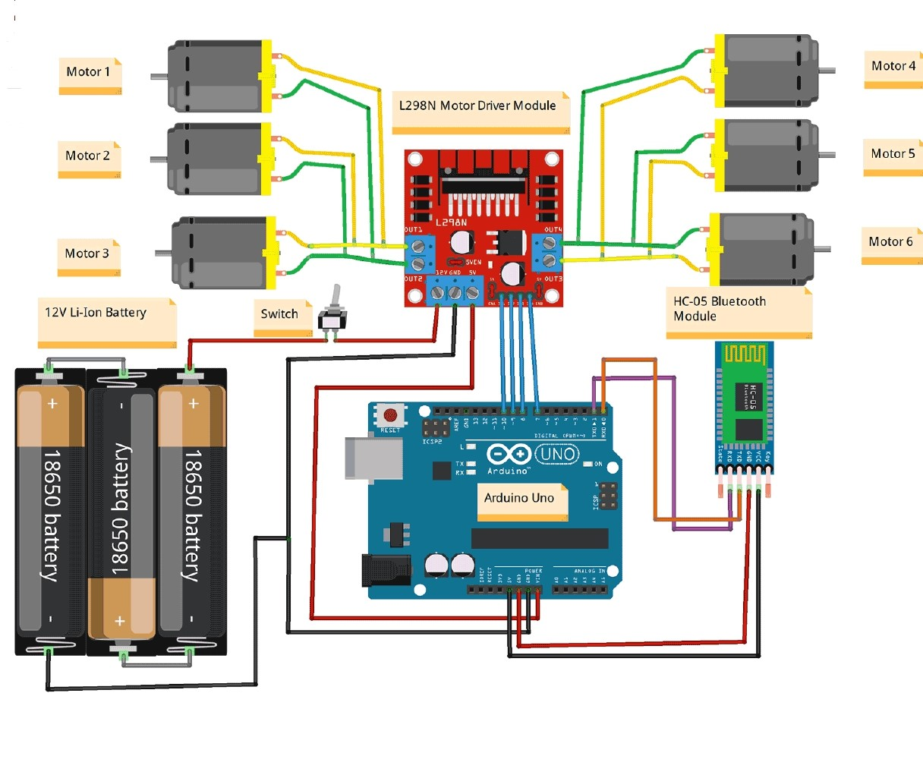
METHODOLOGY
Circuit diagrams:

Slide 5
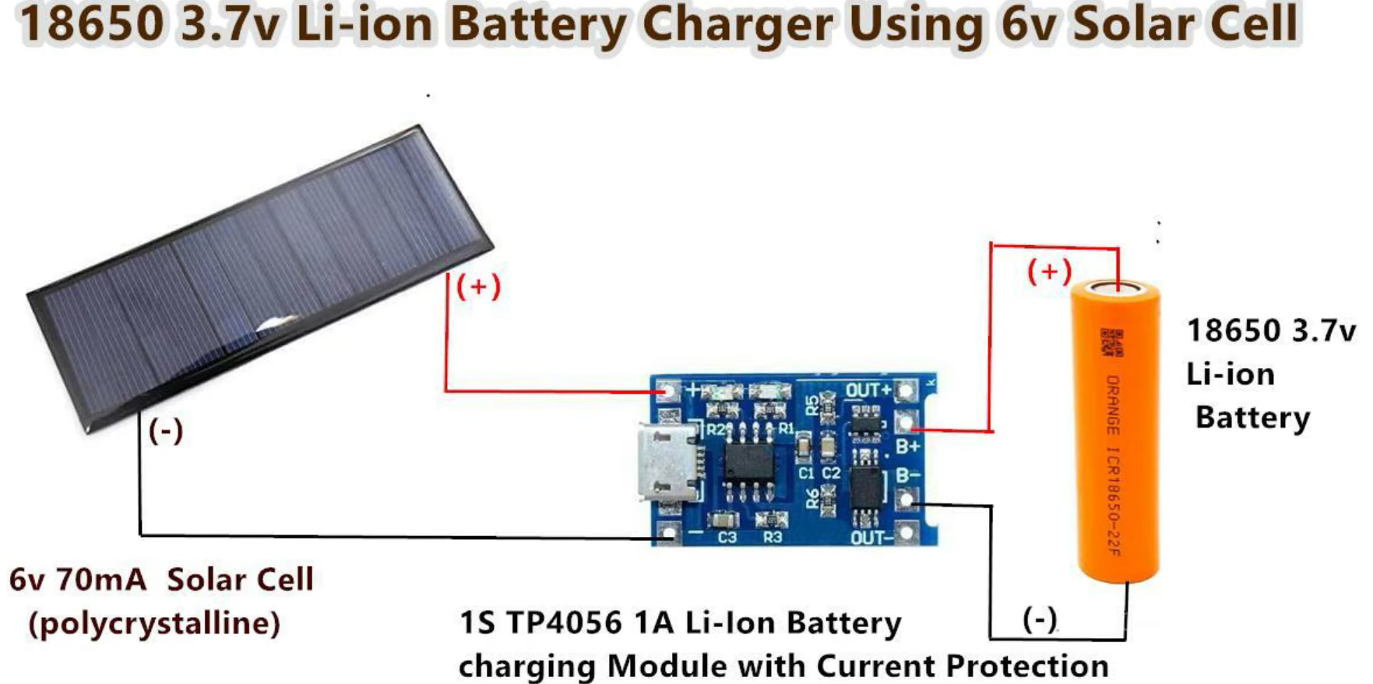

Slide 6
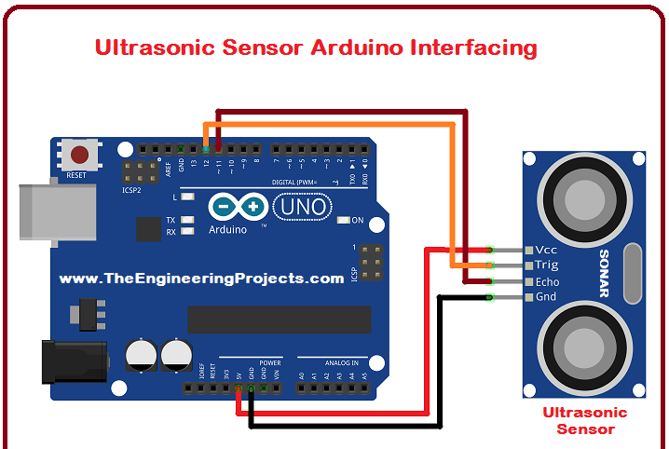
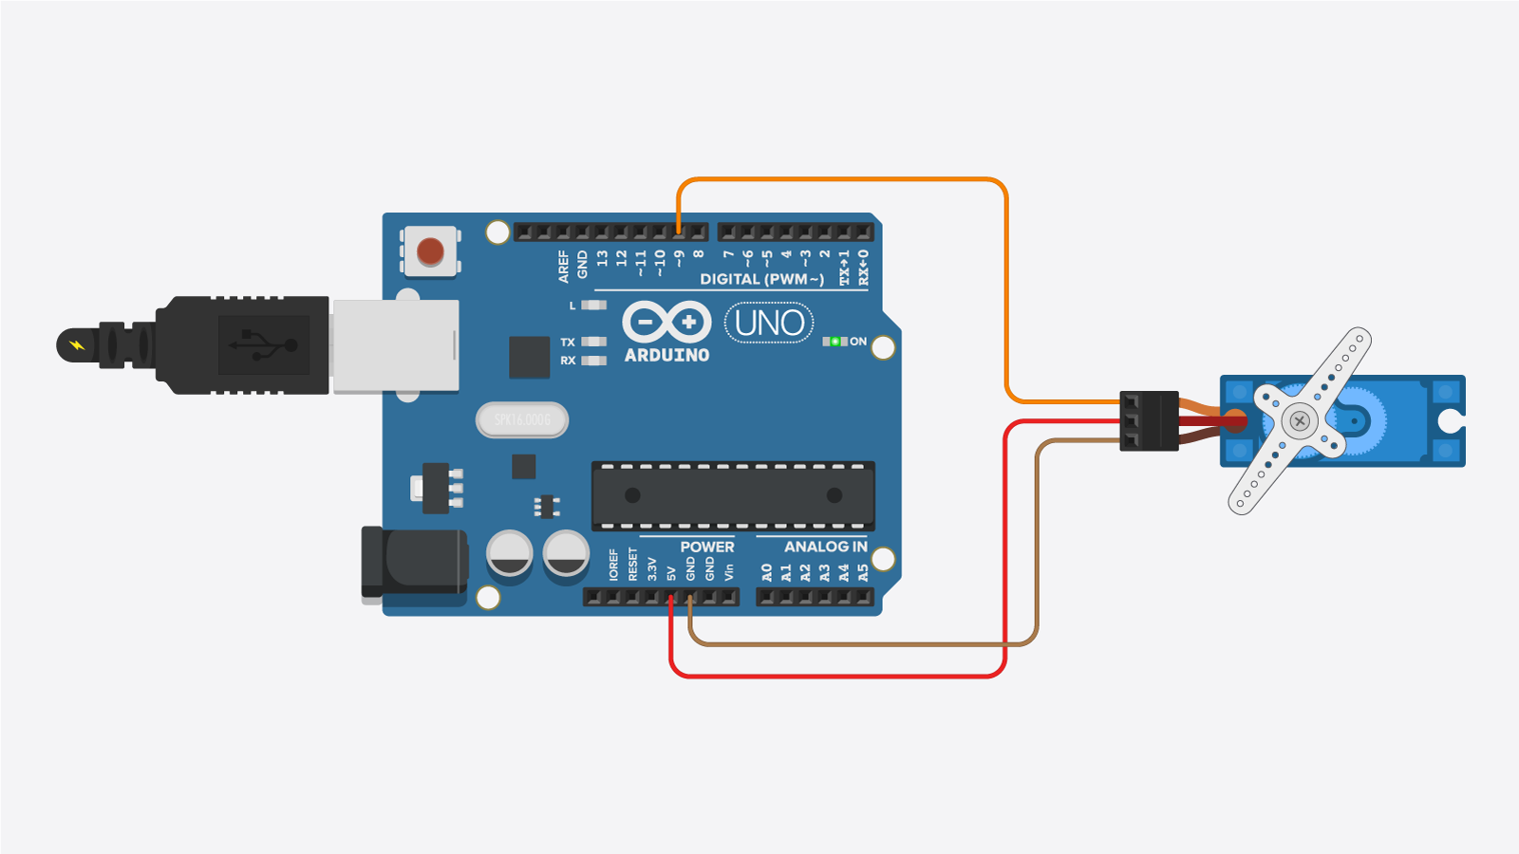

Slide 7
DESIGN
ROVER
L298N Motor Driver
HC – 06
Bluetooth Module
Arduino UNO R3
SG90 Servo &
Ultrasonic Sensor
18650 li-ion Battery 3.7v
TP4056 Charging Module
Solar Panel

Slide 8
LITERATURE REVIEW
1.) Environmental monitoring mini rover based on IoT technology
Authors : Nurul Ayni Mat Pauzi, Seri Mastura Mustaza and Iskandar Yahya
Publication date : 25-January-2021
This research aims to create an IoT-based rover for environmental condition monitoring.
The system uses sensors like humidity, temperature, air quality, and ultrasonic.
The compact size and low development cost make it a cost-effective solution for monitoring and assessing environmental conditions.
The rover is controlled by a mobile application, which monitors data from sensors and camera images.

Slide 9
2.) Low Cost Self-Navigation Rover Based on IOT
Authors : Santosh D Pandure and Pravin L Yannawar
Publication date : September 28, 2018
The research aims to use the Internet of Things (IoT) mechanism on Raspberry Pi.
To monitor abandoned places, contaminated with radiations, gases, or hazardous substances without human intervention.
The rover will self-navigate and post live video feeds to a remote server, with GPS installed for easy location.
This technology will be useful in public and private sectors.

Slide 10
3.) IOT Based Seed Planting and Watering Rover
Authors : G Nagarjuna Reddy, G Maheedhar Reddy, G Balaji, CH Muni Harish, CH Kethan.
Publication date : 2022
The rover, powered by ESP8266 Node MCU DC motors, uses a DHT11 sensor and Wi-Fi module to monitor and upload data.
Equipped with a plough, seed dropper, and water pouring equipment, it estimates seed distance and automatically waters them after 12-24 hours.

Slide 11
OBJECTIVES
Obstacle Avoiding Rover
Android Application
Voice Control

Slide 12
PROPOSED METHOD
Ultrasonic Sensor and Servo Motor will find the Obstacle.
6v mini solar panel and TP4056 module battery will charge.
HC -06 Module we can control the Rover using Android application.
Voice control using application.

Slide 13
CONCLUSION
This project consists of a prototype of a Multifunction Rover as above stated. The prototype Rover can recognize commands from users and can turn the car left, right, and stop with great accuracy. we could make use of this as a surveillance rovers. These Rover could self-monitor under any human supervision, thereby reducing manpower.
Where this rover will be self recharged using the six volts solar panel. As it is rechargeable we can use it continuously without any limit. This multifunction rover can be used as a for observing things around it.
This project is inspired from Pragyan Rover Which is recently launched by ISRO. For exploring the South Pole of the moon.

